Slide 1
Driver Assistance System
Team Members :
Aravind.P
Nachammai Devi Pooja.S
Prathyush.S
Praveen Kumar. V
Under the Guidance of :
Mrs. Angel Deborah (AP) ,
Mr.Sarath Chandran (AP)
Department of Computer Science and Engineering,
SSN college of Engineering,
Kalavakkam ,
Chennai.

Slide 2
Problem Statement:
This project is based on the design and development of a Driver assistance system using signal processing and embedded tools.
The three fundamental modules of this prototype is:
Driver drowsiness detection mechanism
Alcohol content detection module
Vehicle crash detection mechanism
These mechanisms involve interrelated software and hardware sections.

Slide 3
Objective :
To detect the driver fatigue using a rugged mechanism analysing the human eye continuously using image processing tools.
To interface the software module with the hardware components involving the Internet of Things
To produce mechanical vibrations to manually wake or alarm the driver instantly
To detect alcohol consumption using alcohol content detection module.
To alert the other passengers through SMS and internet call.

Slide 4
Proposed System :
This is a promising system expected to aid in the rescuing process by reporting to the concerned person in a matter of seconds the location of the accident, thus lowering death's rates.
The main reason behind accidents is due to the lack of proper sleep and alcohol consumption of the driver.
Generally when a accident takes place, the information is not conveyed to the related persons faster.
This project provides solution for the above concerns.

Slide 5
Innovation:
This system conveys a smart and reliable IoT system solution which instantly notifies the whenever an accident takes place and pinpoints its geographic coordinates on the map.
When an accident takes place, a piezoelectric sensor detects it. Then, an algorithm is applied to process the sensor signal and sends appropriate location.

Slide 6
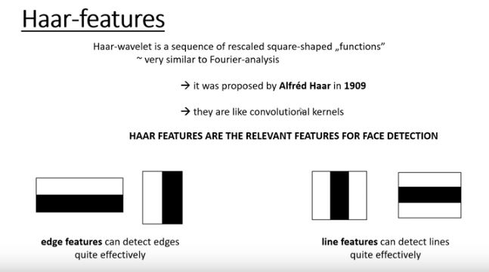
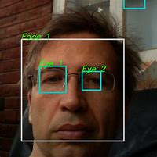
Module 1:
Eyes Localization
Image Processing
Eye closure evaluation

Slide 7
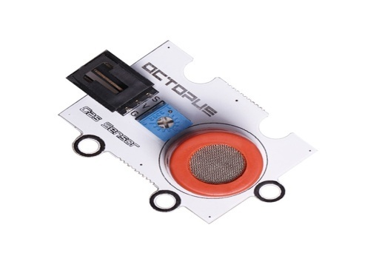
Module 2:
Detection of Ethanol
Adsorption in MQ3 sensor
Alerting phase
Suitable for detecting alcohol concentration in breath , like common breathalyzer.

Slide 8
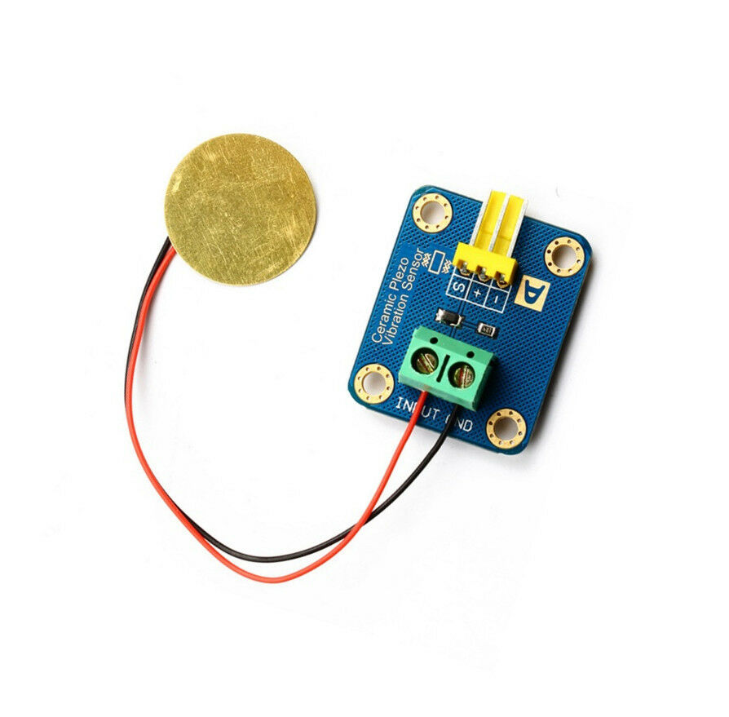
Module 3:
Detection of vibrations
Piezoelectric effect
Alerting phase

Slide 9
Overall process:

Slide 10
Budget details:
ITEM | AMOUNT
Step-down transformer | 700
USB webcam | 1500
12v DC motor | 400
Power supply unit | 700
MQ3 sensor | 200
Piezoelectric sensor | 450
Buzzer | 50
Relays | 300
Sim900 microcontroller | 1350
Raspberry pi 3 | 4800
Connecting wires | 800
Platform chassis | 400
Webcam holder | 200
Total : 13,983(including GST)
Budget sanctioned: 17,000
Remaining budget:3,017

Slide 11
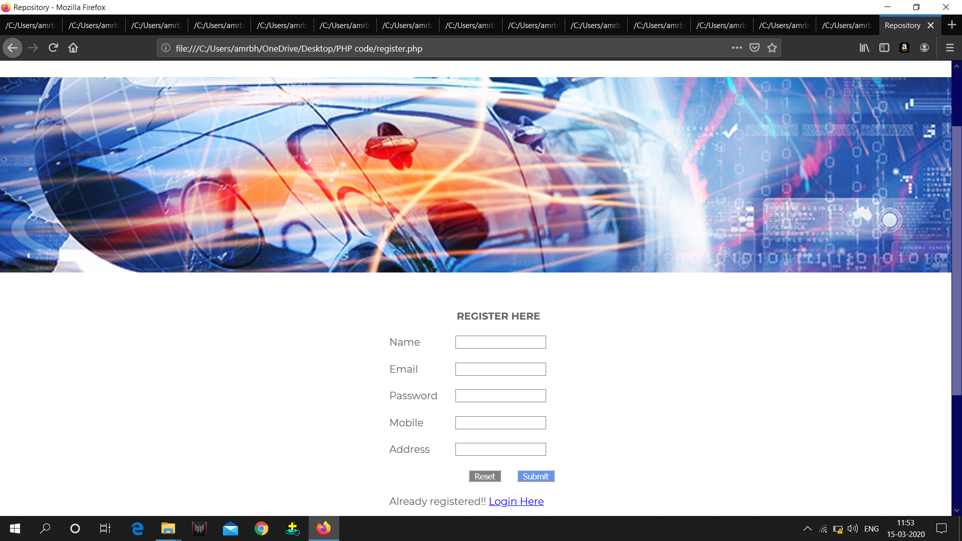
Current implementation:
1.Website:
Implemented: This website gets input of drivers and stores it in database.

Slide 12
Haar-Cascade algorithm:

